Slide 1
Rutgers
17th Fraud Seminar
Fraud – Construction Projects
  Thomas Palczewski
  Director, Internal Audit
  TPalczewski @ NJTransit.com
  973-491-7848

Slide 2
Introduction
Course objective:
  To demonstrate an audit approach designed to identify construction fraud, project cost recoveries and also provide insight to the mindset and necessary skills an auditor must have in order to successfully perform a construction audit.

Slide 3
Safety Briefing
Every job on a Construction Project Usually Starts with a Safety Briefing.

Slide 4
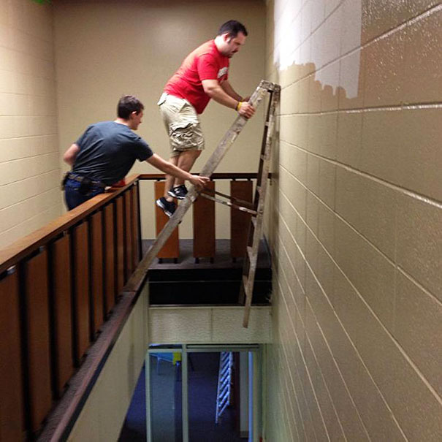
Safety Briefing
Do Not Do This

Slide 5
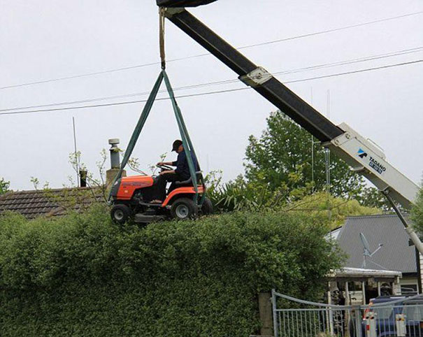
Safety Briefing
Do Not Do This

Slide 6
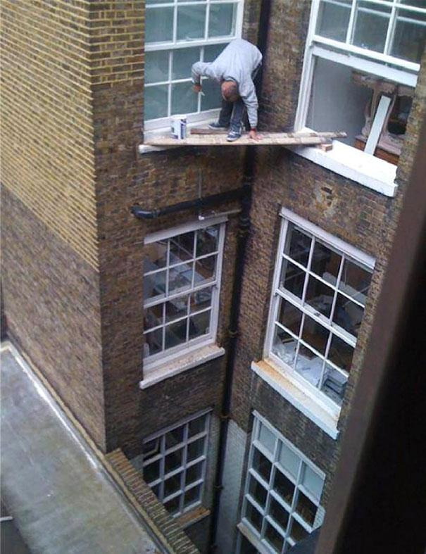
Safety Briefing
Do Not Do This

Slide 7
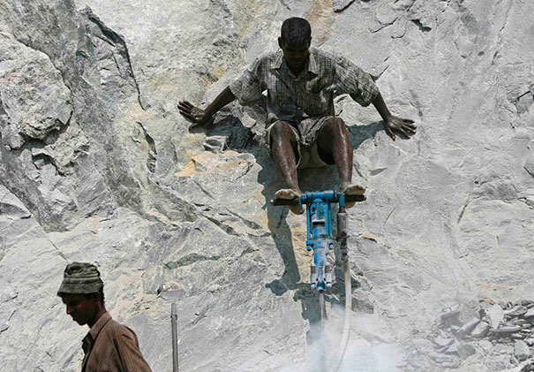
Safety Briefing
Do Not Do This

Slide 8
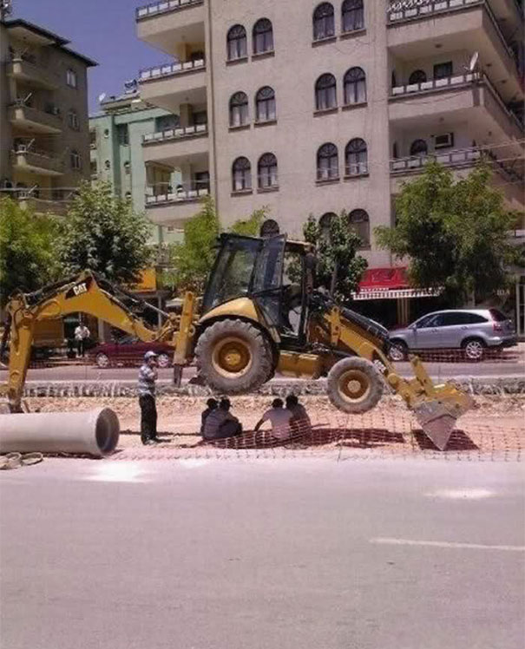
Safety Briefing
Do Not Do This

Slide 9
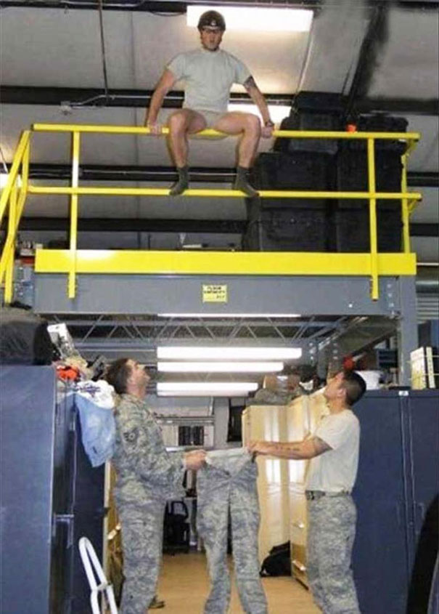
Safety Briefing
Do Not Do This

Slide 10

Safety Briefing
Do Not Do This

Slide 11

Safety Briefing
Do Not Do This

Slide 12
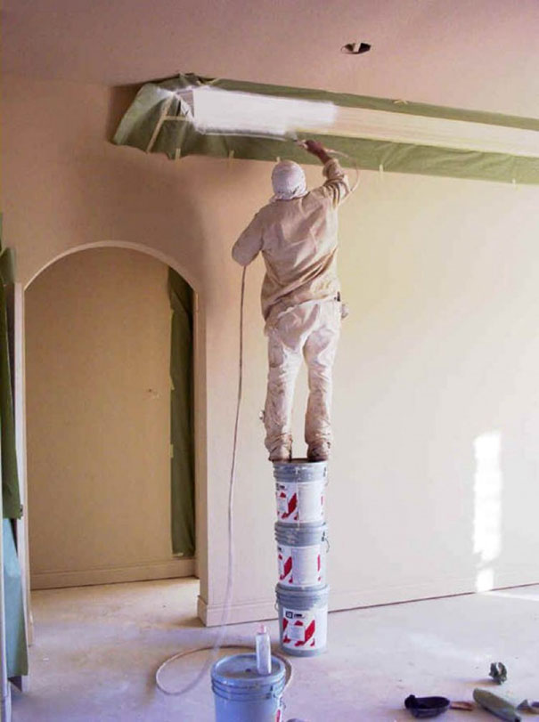
Safety Briefing
Do Not Do This

Slide 13
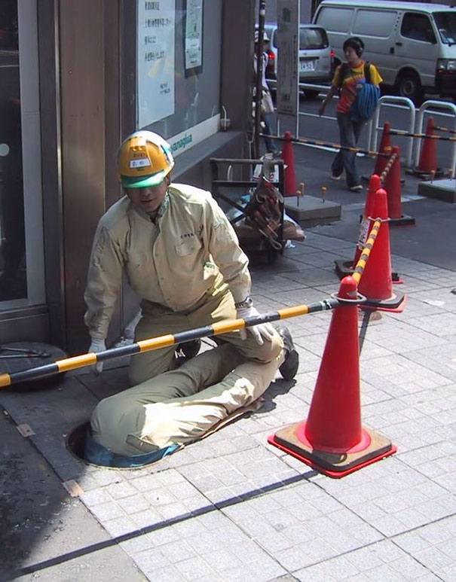
Safety Briefing
Do Not Do This

Slide 14
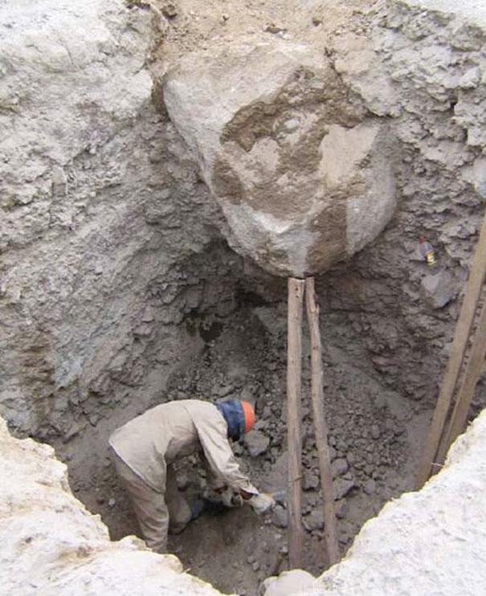
Safety Briefing
Do Not Do This

Slide 15
THE PRACTITIONER’S
BLUE PRINT TO
CONSTRUCITON AUDITING
RON RISNER, CIA, CCA, CCP
IIA RESEARCH FOUNDATION

Slide 16

Giovanni Arnolfini And His Bride by Jan Van Eyck - 1434

Slide 17
Gather Evidence
Visual Observation – Most Basic way to gather evidence.
Examine Records – Often accepted as statements of fact.
Sample Evidence – Does not need to be statistically based but should be representative (reasonable).
Record Notes – Only one chance to capture the details of evidence.
Source: Craig Cochran – Techniques for Gathering Evidence

Slide 18
FOR IMMEDIATE RELEASE Wednesday, August 2, 2017
Owners Of Hudson County, New Jersey, Scrap Metal Company Charged With 17-Year Conspiracy To Defraud Customers
Former Chief Financial Officer Has Pleaded Guilty to Related Charge
NEWARK, N.J. – The owners of ABC Iron & Metal Co. were arrested today and charged with operating a 17-year conspiracy that defrauded customers out of millions of dollars, Acting U.S. Attorney William E. Fitzpatrick announced.
According to documents filed in this case and statements made in court: ABC Iron & Metal Co. which was headquartered in Secaucus, New Jersey, purchased scrap metal for resale and operated three scrap metal recycling facilities in New Jersey. ABC Iron & Metal Co. trucks would deliver scrap metal containers to customer jobsites and remove them after they were filled. ABC Iron & Metal Co. then purportedly paid customers based on the type and net weight of the scrap material.
From 1999 through March of 2016, Jim, Frank and Sam and others allegedly used a variety of fraudulent business practices to buy scrap metal from ABC Iron & Metal Company’s customers for less than ABC Iron & Metal Co. should have paid. The company then resold the scrap metal at a profit.
Instead of paying the proper, agreed-upon amounts for the actual weight, members of the conspiracy used a variety of techniques to misrepresent the true weight and type of the scrap metal, including altering documents to reflect a lower weight, removing scrap metal from a haul before it was weighed and misrepresenting the types of scrap metal contained in a haul.

Slide 19
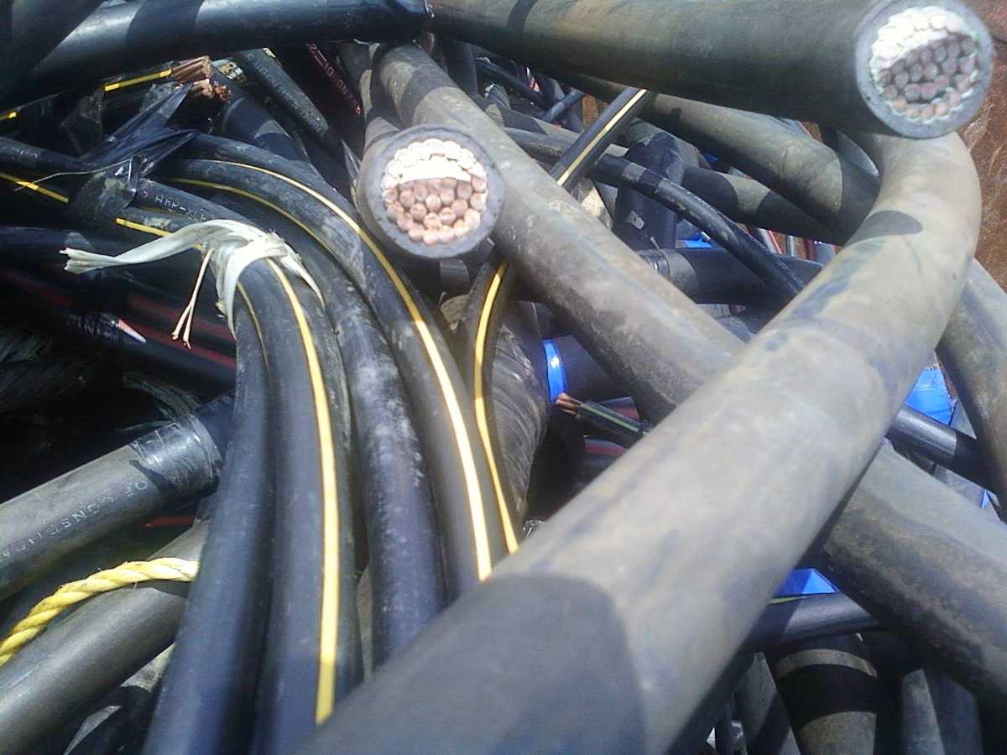
Example of Cable

Slide 20
Project Management
KPMG Service: Advisory, Risk Consulting, Forensic
Type: Survey report
Date: 10/8/2013
Although the engineering and construction industry has made great strides in managing risk, 77 percent of respondents report underperforming projects, due primarily to delays, poor estimating and failed processes.
http://www.kpmg.com/global/en/issuesandinsights/articlespublications/global-construction-survey/pages/minimizing-potential-for-failure.aspx

Slide 21
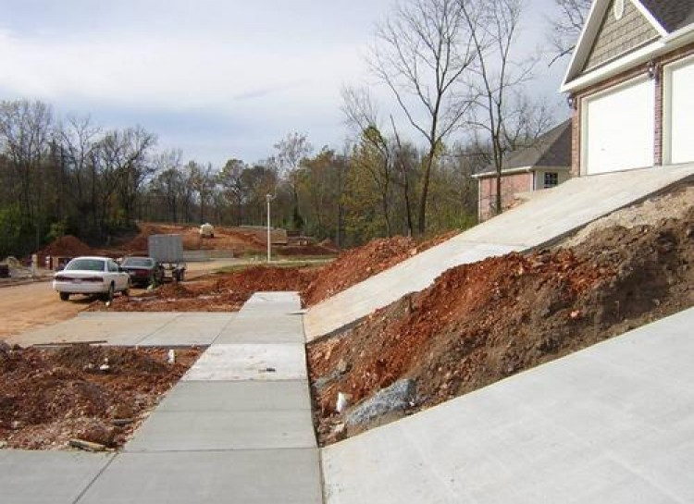
Project Management

Slide 22
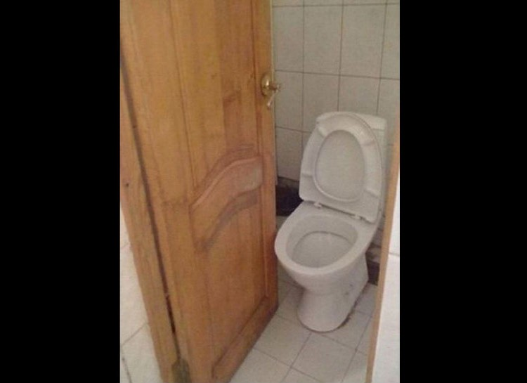
Project Management

Slide 23
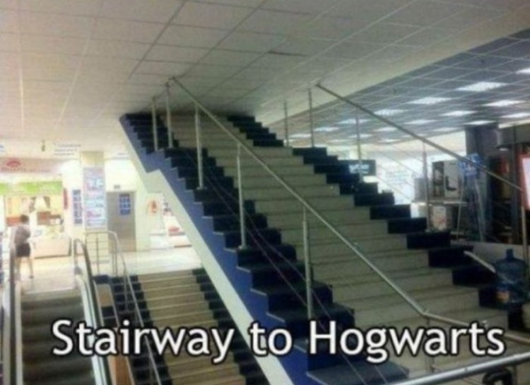
Project Management

Slide 24
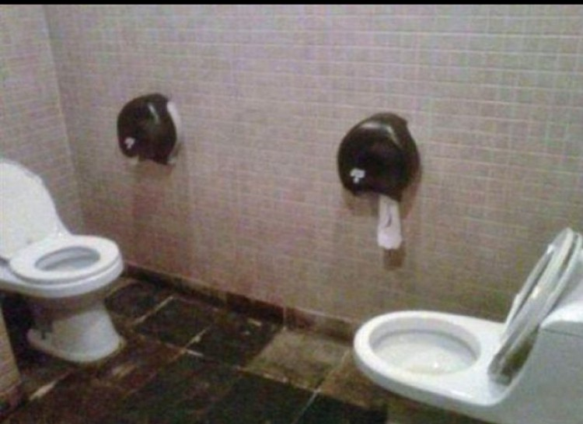
Project Management

Slide 25
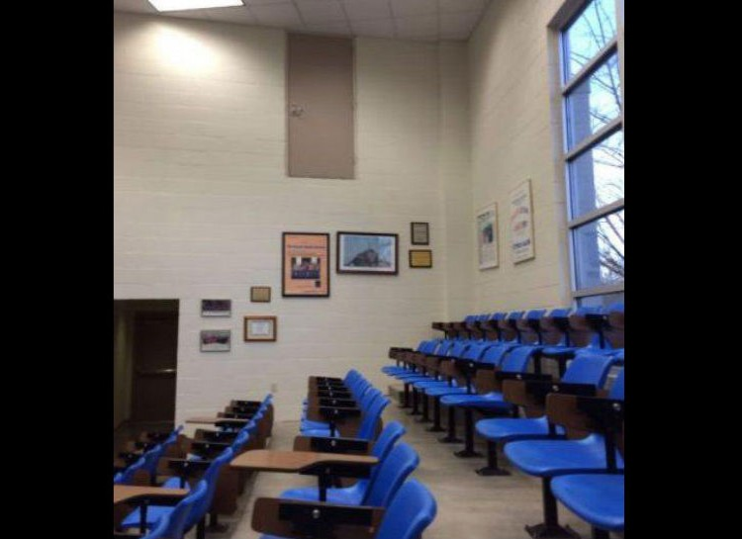
Project Management

Slide 26
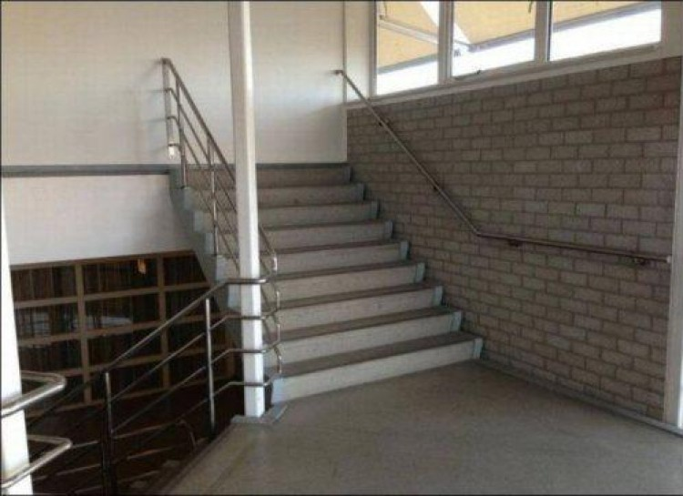
Project Management

Slide 27
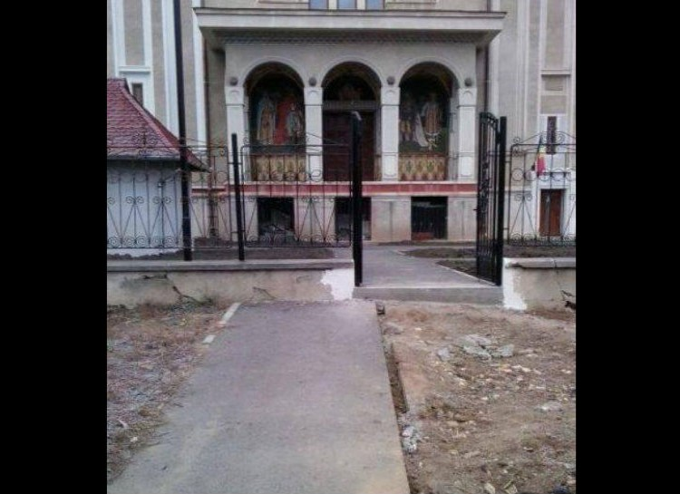
Project Management

Slide 28
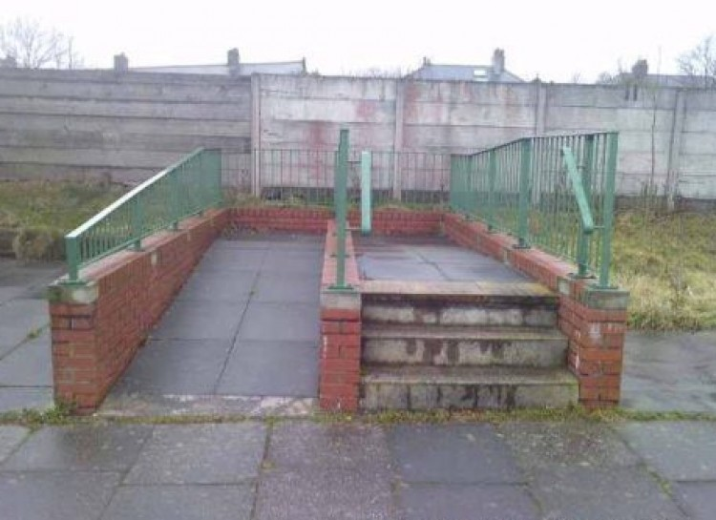
Project Management

Slide 29
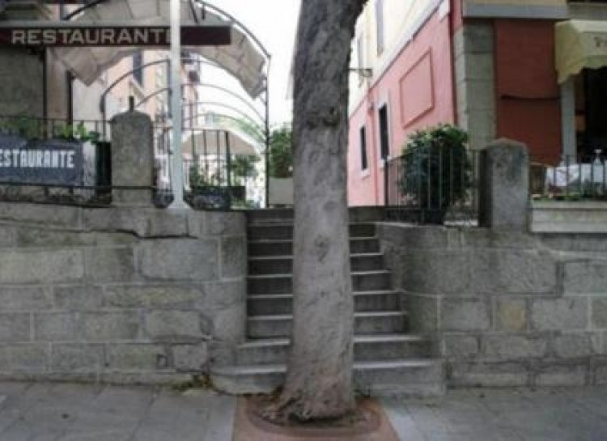
Project Management

Slide 30
Project Management
KPMG Service: Advisory, Risk Consulting, Forensic 10/8/2013 Main Causes of Underperforming Projects:
51% | Project Delays
50% | Poor Estimating Practices
47% | Failed Risk Management Process
37% | Poor Subcontractor Performance
36% | Design Errors and Omissions
20% | Lack of Available Resources
17% | Change In Project Management
16% | Poor Client Relations

Slide 31
Project Management
Goal: Design a plant that meets required goals.
Risk: Architect design exceeds requirements and project is over budget. (Whales)
Goal: Design and Build the World Trade Center Transportation Hub.
Risk: Design Changes result in excessive costs.
    New York Times - Cost swell to $4 Billion. (NYC)
    www.nytimes.com/2014/12/03/nyregion/the-4-billion-train-station-at-the-world-trade-center.html?action=click&contentCollection=Opinion&module=MostEmailed&version=Full&region=Marginalia&src=me&pgtype=article

Slide 32
Project Management
Example of Business Planning Risk:
Goal: A project is fast tracked in order to bring a new product to market.
Risk: FDA delays approval of new product. (Italy)
Risk: Unique equipment is not available upon completion of construction. (Ireland)
Risk: Owner changes their mind. (Massachusetts)
Goal: Construct a new plant in order to expand capacity.
Risk: During construction, capacity requirements change and a new plant is not required. Plant under-utilization is a major concern.
(Ireland - Puerto Rico)

Slide 33
Contracts

Slide 34
Contracts
Guaranteed Maximum Amount (GMA)
Guaranteed Maximum Profit (GMP)
Owner hires a Construction Manager (CM)
The Owner reimburses the CM for incurred costs (General Conditions / Contractors / Suppliers.
CM Profit is limited to an agreed upon fee (percentage). The CM fee is applied to the CM incurred project costs.
The actual GMA amount is typically not finalized until the majority/significant subcontractor or supplier bids have been received.

Slide 35
Project Funding
The Owner must approve Project Funding (CAR).
The project should be managed to the GMA Amount plus a reasonable contingency, not the Project Funded Amount.
A reasonable Contingency should be included within the Project Funding.

Slide 36
Demolition and Restoration Project
Background:
ABC company entered into GMA construction agreements with Toms Construction to perform demolition and restoration at a facility located in California. The demolition and construction was required to return a leased facility back to the landlord based on the terms of the lease.
The GMA contracts were executed and managed by an ABC Project Manager. As the restoration project was coming to a completion, the ABC Project Manager and ABC Facilities Management were severed from the company as a result of the closure of the ABC business.

Slide 37
Demolition and Restoration Project
The Project Manager, on his last day, drove to the construction site in his new yellow corvette and dropped off $587,000 of unsupported change orders.
The Regional Manager of ABC California Site Operations became responsible for project close out. The Regional Manager noted that project documentation did not adequately support the invoices and change orders submitted for payment.
As a result, Corporate Internal Audit was requested to assist in reconciling the amount to be paid to Toms Construction.

Slide 38
Demolition and Restoration Project
GMA: Interior Demolition - $ 865,000
GMA: Restoration - $ 1,920,000
Total - $ 2,785,000
All work was paid under Firm Fixed Contracts
Modifications / Change Orders:
Demolition - $240,000
Restoration - $347,000
Total - $587,000
Under a GMA contract, the Construction Manager is paid for costs incurred up to the amount of the GMA / GMP plus an agreed upon fee.
1st Step: Confirm Costs Incurred.

Slide 39
Demolition and Restoration Project
Request Toms Construction to provide cancelled checks paid to contractors.
2nd Step – Agree Toms Company payments (cancelled checks) to subcontractors to the amount Toms Company invoiced to ABC Company.
Results:
Toms Construction provided Audit with “Contractors Release From Lien”. Cancelled checks were not provided.
3rd Step – Inform Toms Construction that outstanding payments and retention will not be paid until all records are reconciled.

Slide 40
Demolition and Restoration Project
Total Toms Construction Billings to Project: $2,785,000
Toms Company provides Audit with
cancelled checks: $1,170,336
Missing Costs allegedly incurred: $1,614,664
Toms construction could not account for $1,614,664 of Billings to ABC Company.
$800,000 could not be matched to specific line items (Paint, Sheetrock and Carpentry).

Slide 41
Demolition and Restoration Project
4th Step – Obtain subcontractor invoice for Paint, Sheetrock and Carpentry.
Results: Toms Company did not provide subcontractor invoices. Instead, subcontractor bid quotations were provided.
Subcontract work was not competitively bid. Bid quotations do not provide evidence that work was performed.
Toms Company admitted that they obtained high bid quotations and then self performed the work.
It is a best practice that Construction Managers (Toms Company) not self perform work.

Slide 42
Demolition and Restoration Project
Auditing could not determine the actual cost incurred by Toms Company to perform paint, sheet rock and carpentry work.
5th Step: Verify cost of Change Orders $587,000:
Previously, Toms Company provided Vendors Release From Lien.
The Release from Lien’s indicated that the outstanding balance for Electric and Plumbing work was $230,000.
$357,000 of the Change Orders represents costs that were not incurred. Documentation did not provide adequate evidence to justify the $230,000 for outstanding Change Orders.

Slide 43
Demolition and Restoration Project
Other Concerns:
Toms Construction overstated their management fee by $230,144.
Duplicate payments of $22,048 were identified.
Project incurred $34,500 in Building Code Improvements which were not contractually required.
Competitive sealed bids were not obtained.
No evidence of ABC Company Project Management review and approval of award of work to subcontractors or suppliers.

Slide 44
Demolition and Restoration Project
Self performed work by the General Contractor should only be allowed on an exception basis, with prior approval by the Owner and reasonableness of cost be clearly documented.
Project related documentation provided no evidence that work was actually performed. Each scope of work should be approved prior to payment.

Slide 45
Demolition and Restoration Project
Toms Construction project billing was not prepared in the required contractual format. Toms Construction billed the project as a lump sum contract. As a result, the project was billed for the total agreed upon GMA plus Change Orders.
The process used to monitor and approve Change Notices lacked the following controls:
  Change Notices were not prepared in the required format.
  Approval of Change Notices was not documented.
  A Change Notice Control Log was not maintained.
  The reasonableness of the Cost of Change Notices was not documented or approved.

Slide 46
Demolition and Restoration Project
Acceleration Payments:
Three Change Notices identified acceleration charges totaling $166,600. Although Project Management approved the acceleration of work, project documentation does not provide evidence that the acceleration costs were actually incurred.
In this case the cost of acceleration charges should be limited to the premium portion of overtime hours paid.

Slide 47
Construction Management
General Conditions

Slide 48
Construction Management
General Conditions
General Conditions represent Indirect Project Costs that are necessary to complete a project:
Example:
    Construction Management Personnel
    Employee Reimbursables
    Temporary Site Facilities and Equipment
    Work location / Furniture / Computers
    General Labor
    Rentals / Small Tools
    Allowances
    Insurance
    Bonds

Slide 49
Construction Management
Completion Concerns:
    Is the work schedule in agreement with the completion date?
    Have project milestones been identified?
    Is there a method of determining the value of work performed?
    Is the value of work performed in agreement with milestones?

Slide 50
Construction Management
The Owner should pre - approve in writing all Construction Management people and their wages who will charge the project.
Construction Management personnel such as Directors and Home Office personnel are generally not billable to the project.
A Man Power Curve identifies the time frame and number of Construction Management people who will charge the project.
The Man Power Curve should be approved by the Owner.
For Budgeting purposes it is necessary to ensure that the
Man Power Curve is adhered to.

Slide 51
Construction Management
A Budget should be established for each Construction Management Person approved to charge the project. This budget should utilize the Construction Management Persons agreed upon burdened rate and duration on site as identified within the Man Power Curve.
It is preferred that Construction Management Billings identify each employee, their approved budget, the current and project to date expenditure and percentage spent.
Daily work day hours must be established.

Slide 52
Construction Management
The Owner reimburses the CM for incurred costs.
Examples of Construction Management overcharges (non- incurred costs):
  The CM does not pay overtime to employee’s, but overtime hours are charged to the project.
  A CM employee is billed to the project for an amount in excess of what the employee is paid.

Slide 53
Construction Management
Tracking Hours Worked:
A reliable method of tracking CM employee hours worked (Gate Pass, Key Card System, Time Sheets, etc.) should be implemented.
Without a reliable tracking system, actual hours worked cannot be determined.

Slide 54
Construction Management
Verify accuracy of Hours Worked and Hourly Rates for each CM employee charged to the project.
This is accomplished by agreeing:
Hours worked per time tracking system to (1) hours charged to the project and (2) CM payroll documentation.
If only time sheets are utilized, evaluate the process used to ensure their accuracy.
Verify whether overtime or premium hours is an allowable project charge.

Slide 55
Construction Management
Typical CM Payroll Overhead Rates:
  Social Security
  Health Insurance
  Vacation
  Holidays
  Sick Pay – Company Allowance
  Retirement Plan – Company Contribution
  Savings Plan – Company contribution
  Insurance Company Contribution
  Federal / State Unemployment Insurance
  Bonuses / Supplemental Compensation (Annual)
  Worker’s Compensation
  Safety / Development Training

Slide 56
Construction Management
Payroll Overhead:
The CM must recover the cost of employee Payroll Overheads. Therefore the cost of each CM employee is comprised of their hourly rate (Unburdened Rate) plus an amount to recover the cost of employing that persons overhead cost (Burdened Payroll Rate).
Payroll Overhead charges and rates should be identified prior to award of contract to CM. Best practice is to verify these rates prior to award or early in the construction process.

Slide 57
Construction Management
  Payroll Overheads:
  Allowable CM Payroll Overheads should be identified. All other CM payroll Overheads should be included in the agreed upon CM Management Fee. Payroll Overheads are not to be a profit center for the CM.

Slide 58
Construction Management
Trade: |  |  |  | Cost:
Trade: |  |  |  | Cost:
6. Current Maximum Fringe Benefit Cost for Salaried Employees:
COMPONENT |  |  | % OF BASE SALARY
a) | Social Security
b) | Health Insurance
c) | Vacation
d) | Holidays
e) | Sick Pay-Company Allowance
f) | Retirement Plan-Company Contribution
g) | Savings Plan-Company Contribution
h) | Insurance-Company Contribution
i) | Federal/State Unemployment Insurance
j) | Bonuses/Supplemental Compensation (Annual)
k) | Worker's Compensation
l) | Safety/Development Training (2d/Mo Max) |  | Hours paid with prior app'l of PM
Total Fringe Benefit Cost |  |  | 0%
NOTE: |  | Fringe benefit costs are to include all payroll related taxes. Fringe benefit costs are subject to audit. The above fringe benefit component list is a representative sample. Add or delete components as appropriate.

Slide 59
Construction Management
  A separate and reduced Payroll Overhead Rate should be identified and approved for CM Contracted Employees.
If the CM Payroll Overhead is overstated, the project will be overcharged because the CM did not incur these costs.
Most Payroll Overheads should not be applied to Premium Hours.

Slide 60
Construction Management
Examples of Excessive CM Overhead Charged To The Project
Some Items May Be Specific To The U.S.
Example – Social Security:
The CM bills for FICA beyond the established taxable salary for each employee.
Example - Health Insurance:
CM Health Insurance costs are charged for CM employees who are not eligible or do not participate in the CM Health Care Program.
Total cost of Health Care is overstated.
Example – Vacation:
CM employees are not eligible to receive CM vacation benefits.
CM Vacation Payroll Overhead Rate overstates the number of vacation weeks employees are entitled to receive.

Slide 61
Construction Management
Examples of Excessive CM Overhead Charged To The Project:
Some Items May Be Specific To The U.S.
Example - Holidays:
The CM Holiday Payroll Overhead Rate is applied to CM Contracted employees or is not consistent with holidays that the CM provides to their employees.
Example – Sick Pay:
The CM Sick Pay Payroll Overhead Rate exceeds the actual sick days used by CM Employees or is applied to CM contracted employees.
Example – Retirement / Savings Plan:
Not all CM employees participate in the Retirement / Savings Plans.

Slide 62
Construction Management
Examples of Excessive CM Overhead Charged To The Project:
Some Items May Be Specific To The U.S.
Example – Federal / State Unemployment Insurance:
Unemployment Insurance is charged beyond the Federal or State mandated cut off amount.
  Example - Bonuses / Supplemental Compensation (Annual):
  CM Payroll Overhead Rate for bonus is less than bonus amount paid to CM employees.

Slide 63
Construction Management
Examples of Excessive CM Overhead Charged To The Project
Some Items May Be Specific To The U.S.
  Example – Workers’ Compensation:
  Workers’ Compensation is charged at a rate that exceeds the actual CM cost (8% vs. 4%). Also, the rate charged for Worker’s compensation may be applied to the burdened employee rate rather than the unburdened rate.
  Example - Safety / Development Training :
  CM employees do not incur the amount of training included in the overhead rate charged to the project.

Slide 64
Employee Reimbursables
Typical CM and A/E employee expenses may include:
    Housing
    Airfare
    Meals
    Cell Phone
    Car Rental / Lease / Taxis / Mileage
    Laundry
    Household Supplies

Slide 65
Employee Reimbursables
Unless a prior agreement has been established, reimbursement of CM or A/E employee expense typically follows the CM or A/E Reimbursement Policy.
Prevent problems before they occur – gain agreement in advance…
Who can charge?
What can be charged?
What billing format is required?
Who approves at the contractor and Owner level?
What supporting documents are required?

Slide 66
Employee Reimbursables
Administration of CM or A/E employee expenses can be time consuming and difficult to administer.
Multiple expense reports per employee may result in:
  Duplicate Charges
  Missing receipts
  Unauthorized upgraded flights or hotels
  Math Errors
  Unauthorized Meals
  Car lease (who is authorized)
Where applicable, the use of per diems is encouraged.

Slide 67
Temporary Site Facilities and Equipment
    Temporary Site Facilities and Equipment – Typically Include:
    Trailer – mobilization / de-mobilization
    Furniture / Office Supplies
    Lap Tops / Printers
    Copies / Copiers
    Project Signs
    Telephones
    Electric / Electric Connections
    Toilets
    Sidewalks
    Parking
    Water
    Cars

Slide 68
Temporary Site Facilities and Equipment
A budget should be established for each of the costs to be charged to the project.
Reimbursement of each cost must be incurred.
Receipts should be required.
The items purchased remain the property of the Owner.
Items considered to be a fixed asset should be recorded and tracked with a fixed asset number.
Expenditures should take place as required throughout
the project.
Unspent line items should not be spent unnecessarily.

Slide 69
Temporary Site Facilities and Equipment
  Unspent line items should not be transferred to another line item.
Large items such as trailers and labor, etc., should be competitively bid.
  Labor rates and overheads should be verified.
  On a sample basis, CM should provide evidence (cancelled checks) of costs incurred.

Slide 70
RENTAL EQUIPMENT
& SMALL TOOLS

Slide 71
Rental Equipment & Small Tools
Contractor Owned Equipment Rental Charges:
The use of Rental equipment and rates must be approved in advance by the Owner.
The rate cannot exceed 75% of the rate published by Associated Equipment Distributors for Contactor Owned Equipment Rentals
Total rental should not exceed 60% of the fair market value of equipment.
Third Party Equipment Rentals:
Total rental cannot exceed the fair market value of equipment at the time of rental.

Slide 72
Rental Equipment & Small Tools
Routine maintenance and minor repairs may be charged
to the project.
Major repairs are not allowable.
Ensure that rentals are returned in a timely manner.
Be aware of any rentals that may be covered under a lease purchase agreement.
Any rental rebates received by CM should be reimbursed to the project.

Slide 73
Rental Equipment & Small Tools
Small Tools and Consumables should be defined.
Charged at actual cost or as a % of labor or contract
amount.
Small tools and consumables should not be a CM profit center.
Ensure double billing of small tools or consumables
does not occur.

Slide 74
Material
Ensure that Contractor bills for material at actual cost.
Ensure that project is not billed for quantities that exceed
amount actually required / used.
Ensure that credit is received for unused or reusable items.
Ensure that material meets required specifications.
Ensure that material is secure.

Slide 75
Allowances
Allowances may or may not be part of the General Conditions.
Instances may occur where the expense for certain line items has not been identified. When this occurs, an allowance or an estimated amount is identified and included within the GMA.
Ideally, Allowances should not be encouraged.

Slide 76
Allowances
The actual value of the line item in which an Allowance has been assigned must be approved by the Owner prior to the expense being incurred.
Allowance funding in excess of actual cost is not included within the GMA.
Only incurred costs are reimbursed.
Internal Labor should be monitored.

Slide 77
Accounting Controls
Invoice Approval

Slide 78
Invoice Approval
The accuracy and validity of the CM invoice depends on the CM’s invoice preparation process.
Meet with the CM and evaluate how the CM ensures that each charge is accurate and valid.
Example: What process exists to ensure that:
Hours were actually worked.
All hourly rates are correct.
No duplicate charges
Percentage completion of subcontract work is accurate.
Etc.

Slide 79
Invoice Approval
Review the contractor’s procedures
    How are charges generated?
    Who reviews and approves charges/invoices?
    What is reviewed?
    What has the past history with this contractor been like?

Slide 80
Invoice Approval
The standard GMA Contract should specifically identify
and require the invoice format to be used by the CM.
No Exceptions. (AIA – Architect Institute of America)
The following slide provides an example of the Standard
Invoice Format:

Slide 81
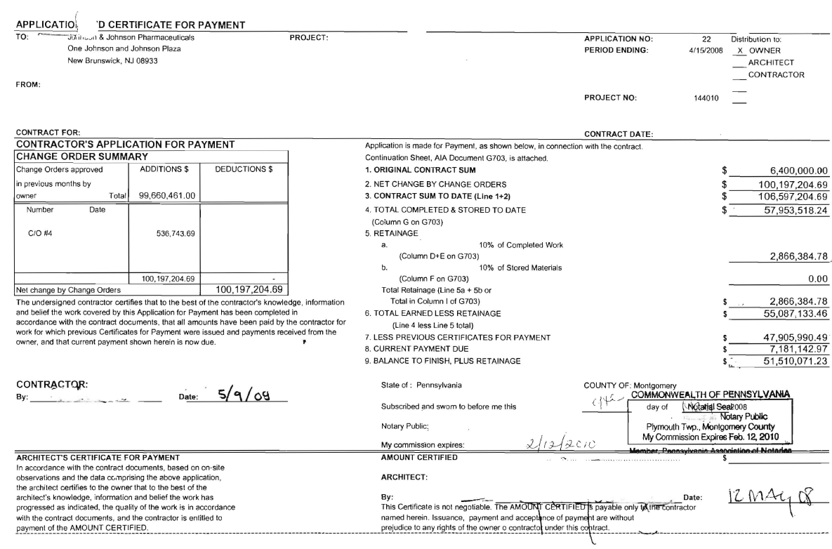

Slide 83
Project Invoice Review
Owner review of invoice must include:
Mathematical Accuracy
Invoice includes necessary receipts.
Verification that costs were actually incurred and allowable per contract.
Proof of subcontract work performed

Slide 84
Project Invoice Review
Owner’s representative should perform a Pencil Review of the invoice. Identified errors should be corrected prior to submission for payment.
Do not withhold invoice from payment for minor errors.
Maintain a list of items to be corrected on next invoice. Do not allow noted errors to remain open for a lengthy period of time.
Invoice should be approved by both the CM and the Owner. Actual approvers should be identified within the contract.

Slide 85
Bonds
Should a project require Bonding.
Does the Owner wish to obtain a performance bond?
What is the criteria for making this decision?
Decision to bond will vary by location, project needs and economic conditions.
SubGuard:
Insurance Policy obtained by the CM.
SubGuard may involve significant rebates.
SubGuard is not recommended because it covers the entire project.

Slide 86
Project Controls
Staff Charges:
Owner approves all CM staff prior to working on or charging the project.
Owner approves CM hourly rates. Reasonableness of CM hourly rates is documented.
CM Home Office charges are limited to specific pre approved items (Computer Support).
Home office directors do not charge the project. Owner must approve exceptions in advance.
Manpower curve is developed and tracked.
A specific overtime policy has been implemented.
A reliable time tracking process has been implemented.
Owner verifies that hours charged were actually incurred and charged at the agreed upon rate.
Owner verifies that CM employees are paid the rate billed to project.
Owner approves in advance the annual CM raises and bonuses.

Slide 87
General Conditions Summary
Payroll Overheads :
A/E's and CMs typically charge a fixed rate to each employees salary for employer payroll overheads costs such as Healthcare, vacation, sick days, 401K matching, etc.
Owner identifies allowable payroll overhead charges. Non allowable payroll overhead charges are not included in the Payroll Multiplier.
Owner verifies that Payroll Overheads are actually incurred and charged at the correct amount. Each charge is verified .
Example of Areas of Risk:
a) CM Social Security and State Unemployment charges may exceed the legal cut off amount.
b) CM Health Care, Vacation and Sick time, 401K matching and insurance charges may be overstated or not incurred. A specific Payroll Overhead is established of CM contractors. Where applicable, a reduced overhead rate is identified for overtime hours worked.

Slide 88
General Conditions Summary
General Expense:
CM indirect project related costs are charged to the project - Example: Trailers, desks, printers, security, insurance, bonds, auto rentals, water, electric, phones, etc.
The Owner approves a documented budget for each type of general condition expense.
General Condition expense is reimbursed upon proof that expense was actually incurred.
Large dollar items are bid.
Items considered to be fixed assets (desks, computers, printers, etc.) are recorded and tracked. Fixed assets are inventoried upon completion of project.
CM provides receipts for all expenditures. Evidence of receipt should also be verified.
General Condition Expense is monitored and un-spent or under-spent line items are reviewed for necessity.

Slide 89
General Conditions Summary
General Expense:
An Owner approved employee expense policy is established prior to incurred expense.
Owner verifies that CM employee expense is supported with required documentation and in alignment with approved employee expense policy.
Small Tools or Consumables are allowed and cost must actually be incurred.
Insurance charges are properly allocated or charged to the project.
Insurance charges are confirmed as actually incurred. Insurance certificates are current and on file.
For larger items, CM is required to provide evidence (cancelled Checks) that cost was actually incurred.

Slide 90
Kickbacks / Bid Rigging / Bribery
In kickback schemes, a contractor or subcontractor misrepresents the cost of performing work by secretly paying a fee for being awarded the contract and therefore inflating the job cost to the Owner / Government.
In bid rigging, contractors misrepresent that they are competing against each other when, in fact, they agree to cooperate on the winning bid to increase job profit.
Bribery occurs when a contractor misrepresents the cost of performing work by compensating an official for permitting contract overcharges to increase contractor profit.

Slide 91
Kickbacks / Bid Rigging / Bribery
Manhattan D.A. Levels Charges In Major Electrical Contracting Kickback Scheme
Today, the Manhattan D.A.’s office indicted Daniel Brusso and Barres Electrical Consulting, Inc. for their alleged role in a construction bribery scheme. The indictments follow a three-year investigation into bribery and fraud in the electrical contracting industry that has resulted in charges being brought against more than 15 companies and 17 individuals, some of whom have already pleaded guilty.
Mr. Brusso allegedly engaged in a bribery scheme that steered millions of dollars of business from XYZ Electrical Company, of which he was the purchasing agent, to electrical supply companies.

Slide 92
Kickbacks / Bid Rigging / Bribery
Five Lewis Library contractors plead guilty in bribery investigation. More than $100K paid to Skanska construction manager in exchange for contracts
ByMendy Fisch • Staff Writer • July 15, 2008
Five contractors who worked on the soon-to-be-opened Lewis Library have pleaded guilty to paying more than $100,000 in bribes to a construction manager to obtain construction contracts. Four contracts were involved, valued between $660,000 and $1.9 million each, according to The Times of Trenton, which first reported on the case earlier this month.

Slide 93
Kickbacks / Bid Rigging / Bribery
Former Con Ed Employees and Private Contractors Sentenced for Their Roles in Bribery Schemes
Fourteen former construction inspectors for Consolidated Edison Corporation of New York, Inc. (“Con Ed”) have been sentenced on charges stemming from schemes in which they solicited and accepted millions of dollars in kickbacks from contractors between 2000 and 2009 in connection with construction projects in Manhattan, the Bronx and Westchester County. Also sentenced were two contractors for paying kickbacks and the brother-in-law of one of the inspectors for laundering bribe payments to conceal their true nature and source. All of the sentencing proceedings were held before United States District Court Judge Allyne R. Ross at the federal courthouse in Brooklyn.

Slide 94
Kickbacks / Bid Rigging / Bribery
Red Flags
1 | Favoritism of Bid Selection Committee
2 | Same companies win the bid
3 | Unexplained or unreasonable limitations on the number of potential subcontractors contracted for bid or offer
4 | Continuing awards to subcontractors with poor performance records
5 | Non-award of subcontract to the lowest bidder
6 | “No-value-added” technical specifications that dictate contract awards to particular companies. Non-qualified and/or unlicensed subcontractors working on prime contracts
7 | Non-qualified and/or unlicensed subcontractors working on prime contracts.
8 | Poor or no established contractor procedures for awarding of subcontractors.

Slide 95
Kickbacks / Bid Rigging / Bribery
Red Flags
9 | Lack of separation of duties between purchasing, receiving and storing
10 | Purchasing employees maintaining a standard of living exceeding their income
11 | Gifts / Illegal Gratuities
12 | Complimentary bidding
13 | Bid Rotation
14 | Sole Sourcing (No options – only provider for material or services)
15 | Single Sourcing (Choosing a specific company and bypassing the competition)
16 | Threats (Goodfellas)

Slide 96
Kickbacks / Bid Rigging / Bribery
Red Flags
17 | Preferential treatment to a contractor
18 | Lifestyle that exceeds a persons salary
19 | Change orders lack sufficient justification
20 | Oversight Officials socialize with or have business relationships with , contractors or their families
21 | Unnecessary middleman or brokers
22 | Contracting employee declines promotion to a non-procurement position
23 | Keen or preferential interest by a contracting employee to award a contract to a particular contractor or vendor

Slide 97
Bid Process Controls
Often Over Looked and Necessary Controls
1 | Construction Company’s and Owners Ethics and Integrity Program
2 | Bid Check Estimate

Slide 98
Bid Process Controls
Competitive Bid Process Purpose: Ensure adequate control exists to ensure that competitive bids are obtained, evaluated and awarded in a fair manner.
1 | Criteria has been established as to when a competitive bid is required and how many bids should be obtained.
2 | Criteria established as to what does and does not constitutes a bid. Example: Should bids that excessively exceed anticipated costs (Courtesy bids) or No bids (no interest) be considered to be a competitive bid.
3 | When less than three bids are obtained, exception approval is obtained from an independent authority. Justification of exceptions are documented.

Slide 99
Bid Process Controls
Solicitation and Receipt of Competitive Bids
1 | Bidder qualification attributes have been determined.
2 | Qualified bidders identified by Construction Manager (CM) and Owner.
3 | Qualified bidders are approved by the Owner.
4 | Request For Proposal (RFP) format established and approved.
5 | Approved Bidders confirm that they are interested in bidding.
6 | RFPs are sent to an adequate number of approved bidders.
7 | Approved bidders attend the Pre Bid Clarification Meeting (Usually Together).

Slide 100
Bid Process Controls
Solicitation and Receipt of Competitive Bids
8 | Owner response to Subsequent Bid related questions is available to all bidders.
9 | RFP identifies a specific bid due date.
10 | Obtain documented reasons as to why interested bidders did not submit a bid (Reasons are usually generic in nature).
11 | Bids are opened at a designated time.
12 | Date of bid opening is documented.
13 | Opening of bids is witnessed by more than one person and bid total is documented.
14 | Late or delayed bids are rejected or all other bidders are granted a similar delay.

Slide 101
Bid Process Controls
Evaluation of Competitive Bids - Commercial Terms
 | Each bidder is qualified. A decision has been made to award bid solely on commercial terms.
1 | A person with appropriate experience and knowledge and independence normalizes each bid.
2 | Bids are normalized in a consistent manner (line by line).
3 | Owner's questions related to each bid package are documented in advance of bid clarification meeting.
4 | More than one Owner representative attends the post bid clarification meeting.
5 | Significant differences between each bidders line item and estimates are questioned or resolved.
6 | Reasons for changes to bid are documented and identified to a specific line item or bill of quantities.
7 | Management has established a policy regarding whether bidders will be requested to make a final and best offer.

Slide 102
Bid Process Controls
Evaluation of Competitive Bids - Commercial Terms
8 | If applicable, each bidder has equal opportunity to provide a final and best offer. (Reference #7 above).
9 | Owner should approve subcontractors who work for the successful bidder.
10 | A Recommendation of Award letter is prepared in a standard or pre approved format. Award letter should identify the estimate and line item detail for each bid.
11 | The Owners approval of award is documented prior to commencement of work.
12 | Equipment prices should be compared to Global Strategic Alliance Agreements.
13 | When applicable, unit pricing is provided and considered during the bid evaluation process.

Slide 103
Bid Process Controls
Owner may consider commercial and non commercial terms (Construction Experience, Technical Ability, Safety, etc.) in determining the successful bidder. Non Commercial terms are typically considered for selection of A/E, CM larger subcontract work and procurement of some equipment. When non commercial terms are evaluated, the following controls should be implemented:
1 | Bids should be opened simultaneously.
2 | Criteria and weight of all terms to be considered are determined prior to opening of bids.
3 | A cross functional group should participate in the scoring or assignment of value for terms to be considered (Matrix Approach).
4 | The scoring and scoring process should be documented.
5 | Procurement should monitor to ensure that the voting or scoring process is performed in a fair or unbiased manner.

Slide 104
Bid Process Controls
Sole or Single Source Suppliers
1 | Legitimate justification of Sole or Single Source Suppliers is documented and approved by Procurement.
2 | Pricing is compared to current documented quotations or recent prior purchases of similar services or equipment. Where applicable, Single sourced items are bid.
3 | Price is discounted to reflect single source supply.
4 | Price should be consistent with existing Global Strategic Supplier Agreements.

Slide 105
Bid Process Controls
Reverse Auction Bidding
1 | Established policy indicates when Reverse Auction bids are allowed.
2 | Scope of work or equipment specifications must be clearly defined.
3 | Pre bid and Bid Clarification meetings may be required.
4 | A policy should be established for determining the starting bid amount.
5 | Individual bidding is highly documented.
6 | Successful bidder identifies specific line items in which bid will be reduced or increased.
7 | Owner must ensure that bidder can complete work for bid amount.

Slide 106
Good Luck With Your Project.
Questions:
Feel free to contact me at any time.

